Slide 1
Guru Propeller Plane B ’23 Diagrams
Propeller Ikara brand with Nose hook attached with glue and thread wrap
Tip Plates foam
Rear Stabilizer
Wing posts- Basswood 1.6mm thick
50mm L x 1.6mm square
Main Wing
Motor less than 2.0g
Rear hook
Sewing pin bent to Z shape and attached with glue and thread
Tail Boom
Balsa 1/8” square
Wing Tube Plastic (2plcs)
12mm L x1.6mmx1.6mm square ID
Wing Tube Cradle Balsa
Rear Fin(s) Foam
Fuselage Balsa
With 3k carbon fiber glued reinforcement

Slide 2
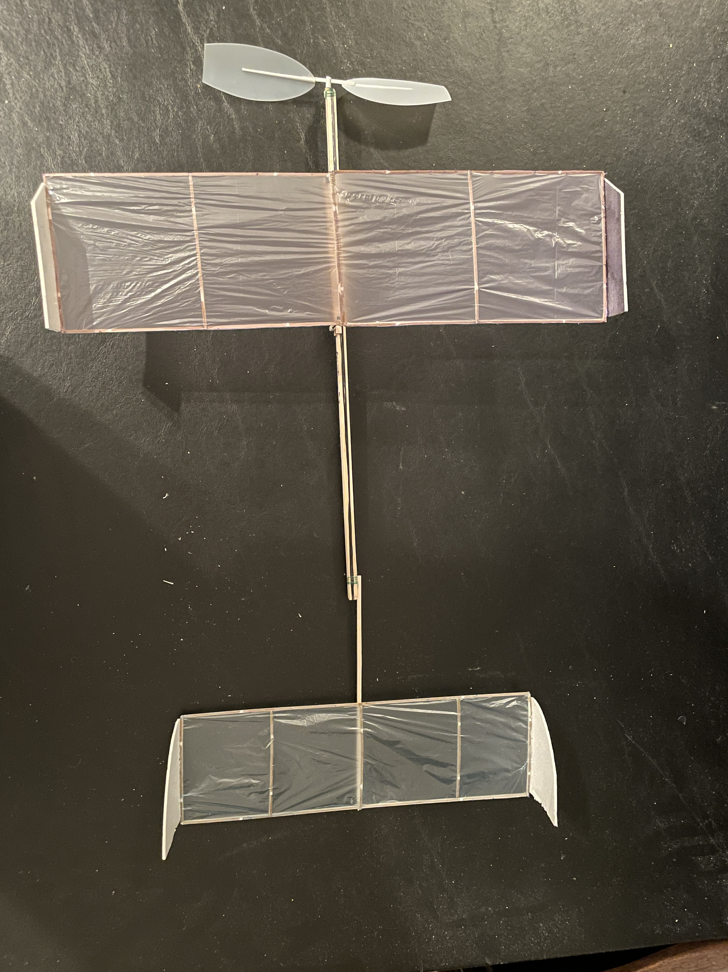
Guru Propeller Plane B ’23 Diagrams
Wing tip completely black
Leading edge Balsa 1.6mm x 1.6mm 2ply glued
Team Name
Trailing edge Balsa 1.6mmx1.6mm
Wing ribs
Laser cut from 1.6mm thick sheet
Wing / Stab Covering
Plastic film 0.6mil
Stab ribs
Laser cut from 1.6mm thick sheet

Slide 3
Guru Propeller Plane C ’23 Diagrams
Propeller Ikara brand with Nose hook attached with glue and thread wrap
Tip Plates foam
Wing posts- Basswood 1.6mm thick
50mm L x 1.6mm square
Rear Stabilizer
Main Wing
Motor less than 2.0g
Rear hook
Sewing pin bent to Z shape and attached with glue and thread
Fin Adjust Post
plastic
Wing Tube Plastic (2plcs)
12mm L x1.6mmx1.6mm square ID
Wing Tube Cradle Balsa
Rear Fin(s) Foam
Fuselage Balsa
With 3k carbon fiber glued reinforcement

Slide 4
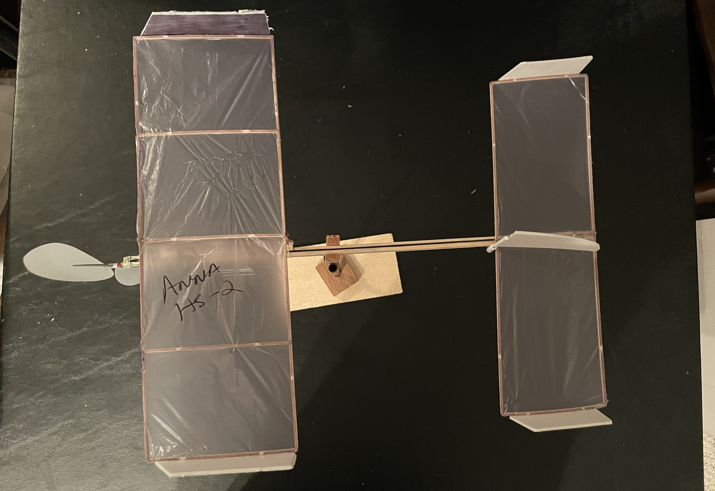
Guru Propeller Plane C ’23 Diagrams
Wing tip completely black
Leading edge Balsa 1.6mm x 1.6mm 2ply glued
Trailing edge Balsa 1.6mmx1.6mm
Team Name
Wing ribs
Laser cut from 1.6mm thick sheet
Wing / Stab Covering
Plastic film 0.6mil
Stab ribs
Laser cut from 1.6mm thick sheet

